Slide 1
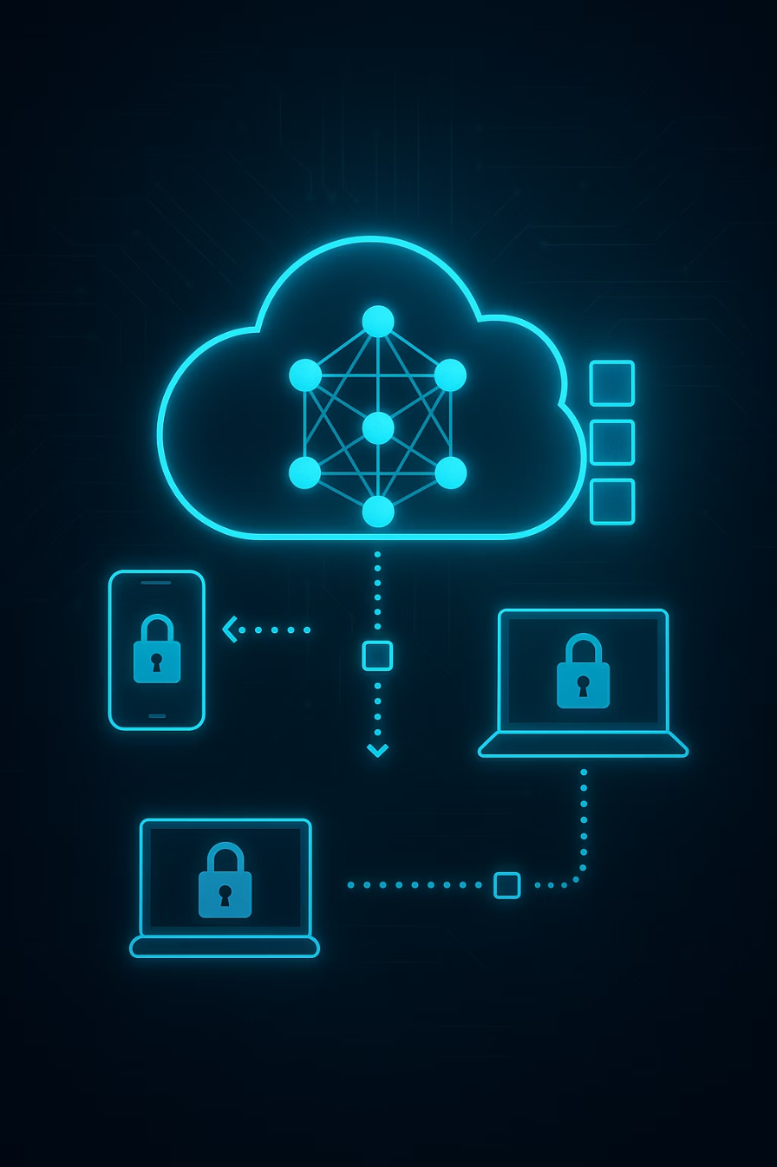

Hierarchical Federated Learning with Low-Rank Adaptation (HFL-LoRA): Adaptive Clustering for Efficient Federated Fine-Tuning of LLMs
Presenters: Gaurav S, Atishay Jain, Garvil Kumar Shah
Course: CS 595 - Decentralized Machine Learning Systems
Date: 3 December 2025
1

Slide 2
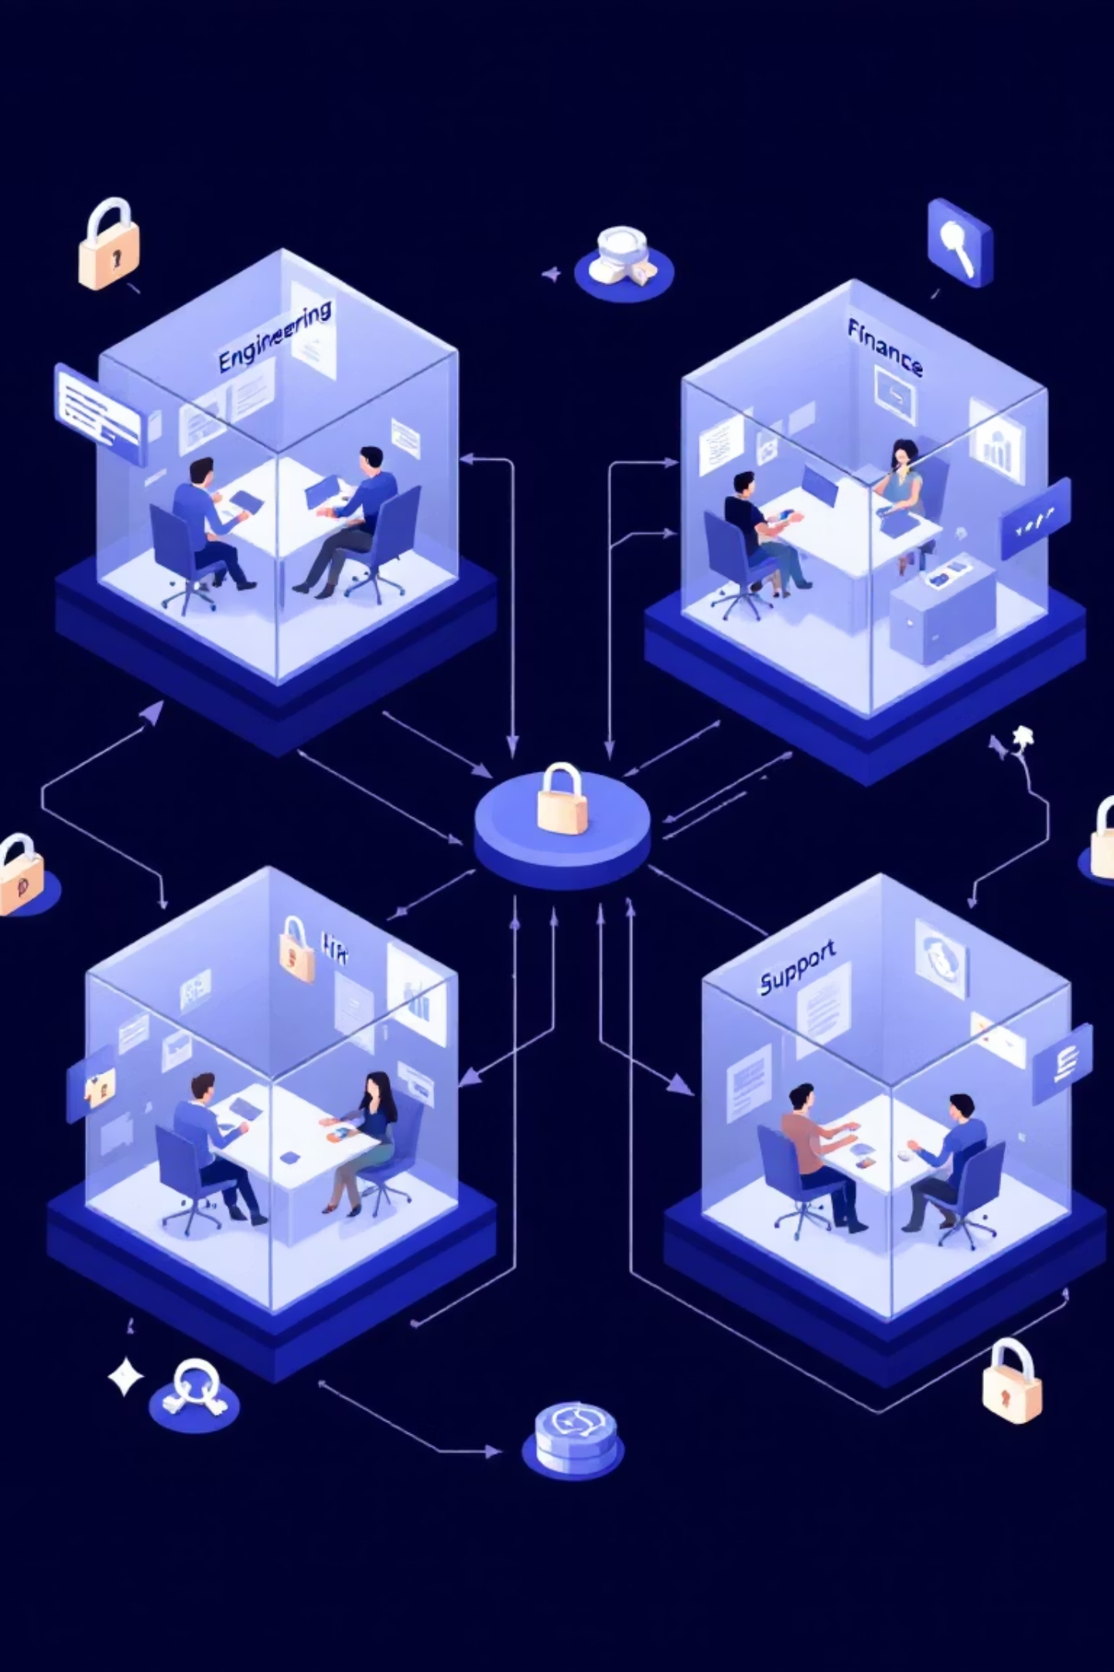
The Enterprise Silo Problem
Department-specific language (Engineering, Finance, HR, Support)
Negative transfer when one global model tries to learn conflicting domains
Separate models = expensive and lose shared linguistic structure
Privacy barriers prevent centralizing sensitive text data
2

Slide 3
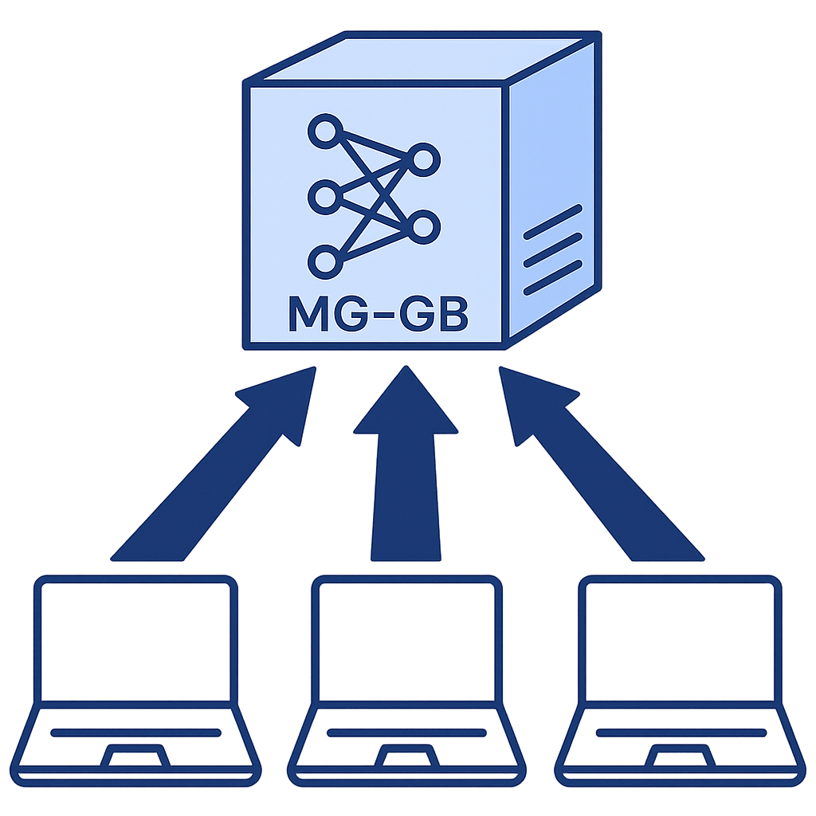

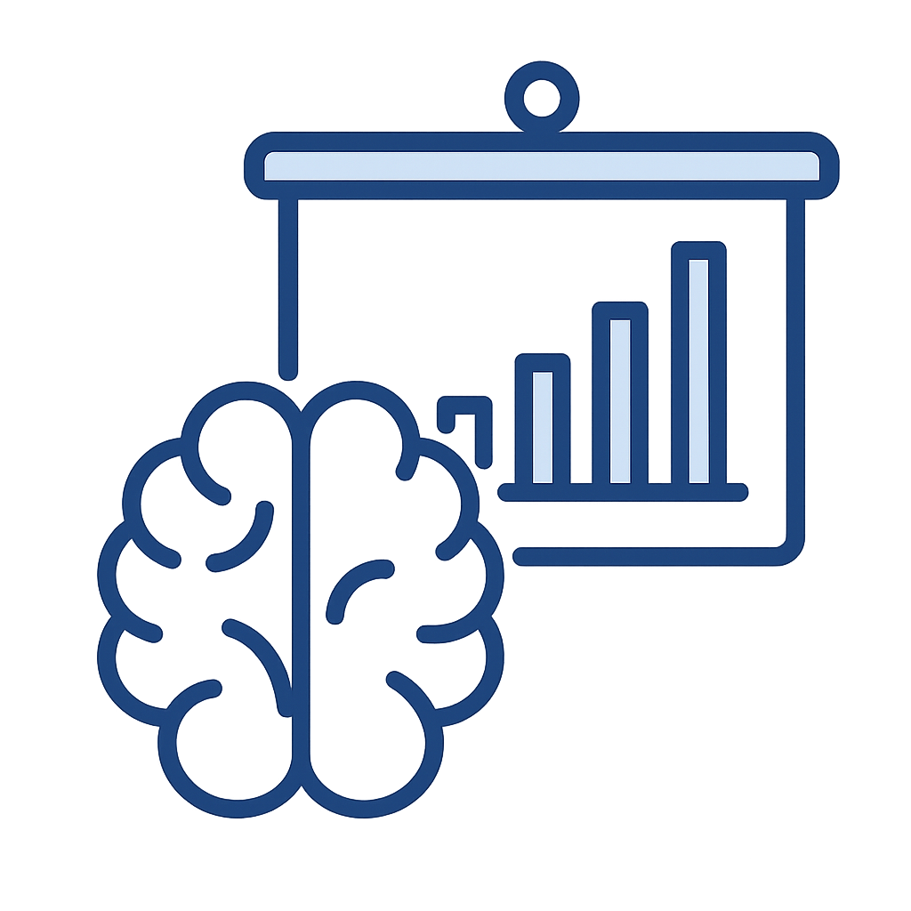

Why Federated Learning Is Not Enough
High communication cost
Client Drift and Instability
Poor domain specialization
(LLMs = multi-GB updates)
Unstable & oscillating training
Global model forgets department-specific patterns
3

Slide 4






Our Research Goal
Our objective is to develop a Hierarchical Federated Learning (HFL-LoRA) system for Large Language Models (LLMs) that specifically addresses the limitations of traditional Federated Learning in enterprise environments. We aim to build a system that is:
Efficient communication for billion-parameter LLMs
Strong privacy (no raw text leaves clients)
Department-level specialization
Stable learning on non-IID data
Automatic client clustering
4

Slide 5

Solution Overview: HFL-LoRA
HFL-LoRA is a hierarchical framework that fine-tunes Large Language Models (LLMs) across decentralized departments.
It combines Intelligent Clustering with Selective Aggregation to balance global reasoning with local expertise.
Pillars of HFL-LoRA
Intelligent Grouping
Selective Aggregation
Stabilized Training
Why This Architecture Wins
Efficient
Smart
Private & Personalized
5
Notes:
1. Intelligent Grouping (The "Who")
What: Instead of treating all clients the same, we group them by semantic similarity.
Method: Automatic Hierarchical Clustering using LoRA A-Matrices to identify which departments (e.g., HR & Finance) share a common "vocabulary."
2. Selective Aggregation (The "What")
What: We don't share everything. We split the model into "General" and "Specific" parts.
Method: FedSA-LoRA Strategy—We aggregate the Shared Matrix globally for reasoning while keeping the Local Matrix private for domain expertise.
3. Stabilized Training (The "How")
What: Federated training often diverges when data is different (Non-IID).
Method: FLoRA Optimization—We use Momentum ($\mu$) and Global Mixing ($\lambda$) to smooth out updates, ensuring the model learns steadily without forgetting.
Efficient: Cuts communication costs by ~50% (sending only half the matrices).
🧠 Smart: Automatically detects organizational structure without manual labeling.
🛡️ Private: Sensitive department context never leaves the local device.
Personalized: The FedSA-Lora Method preserves the personalized data on the client side.

Slide 6
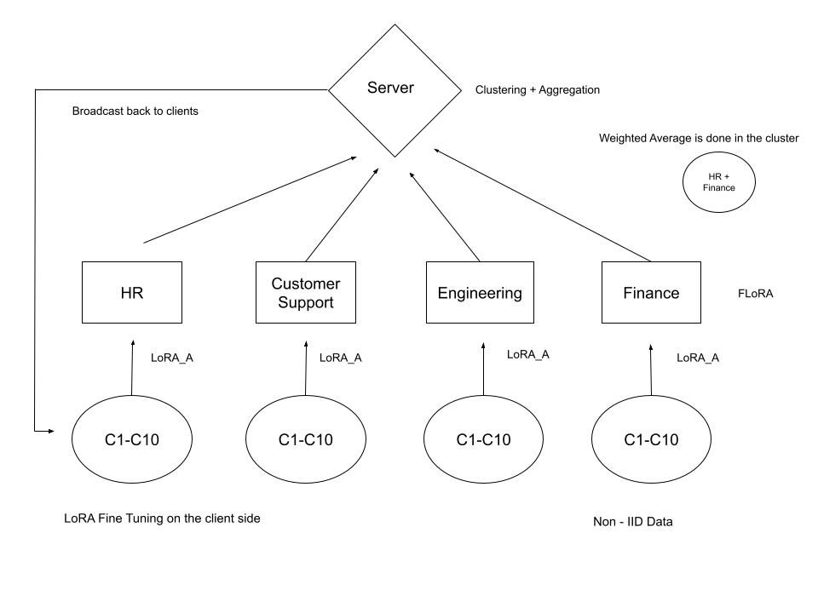

Architecture
6

Slide 7
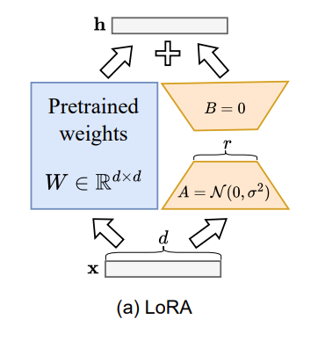
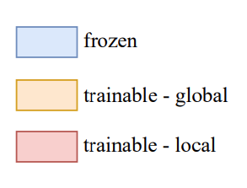
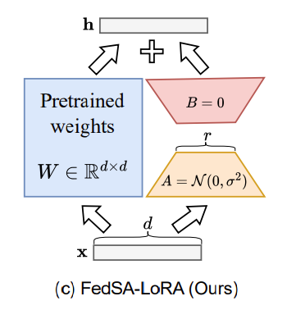
FedSA-LoRA: Selective Splitting Aggregation
🎯 Client Side: Focused Adaptation
📉 50% Communication Reduction
🧠 Domain-Specific Intelligence
🛡️ Enhanced Privacy & Security
7

Slide 8


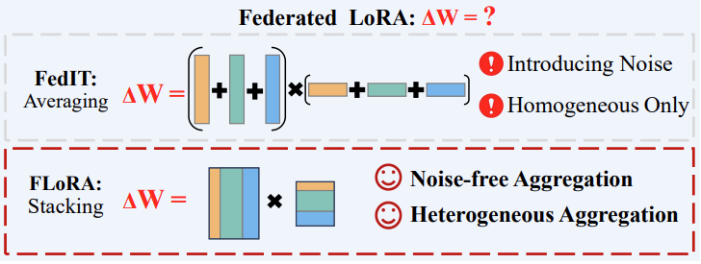
FLoRA: Stacking Aggregation
Strategy
Utility
Eliminating Aggregation Noise
Noise Free Precision
Handling System Heterogeneity
Flexible adaptation
8
Notes:
Why We Chose This (The Strategy)
What It Gives Us (The Utility)

Slide 9
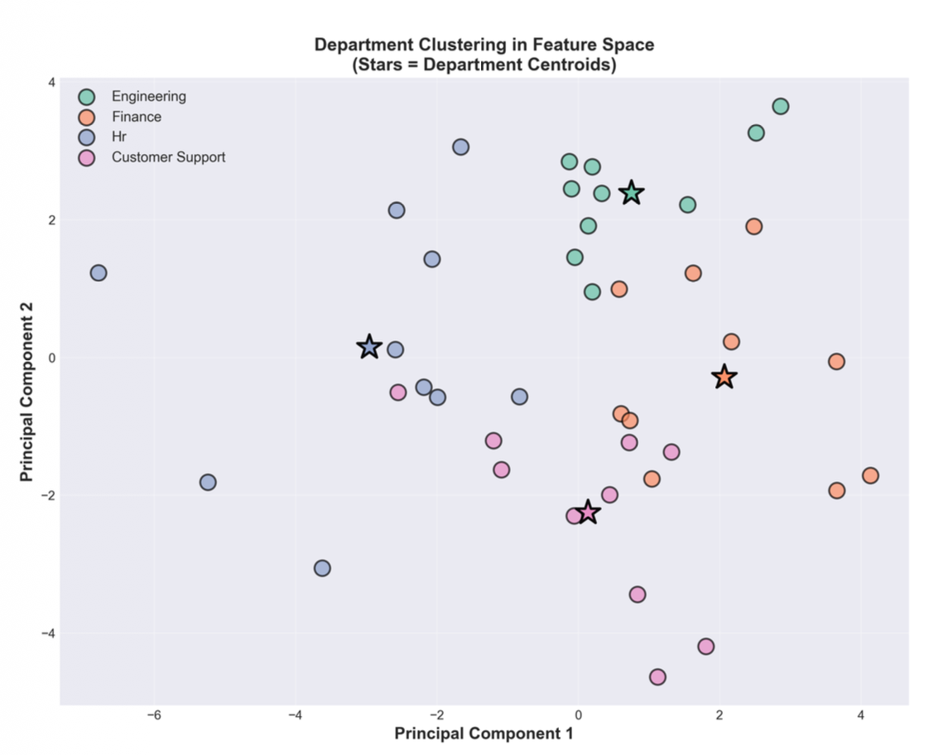
Hierarchical Clustering: Department Level
Mechanism:
Clustering: K- Means
Auto k-selection: Elbow method(2nd derivative)
Embedding source: FLoRA aggregated lora_A matrices
Typical groups detected:
Engineering + Finance (Technical Department)
Customer support + HR (service oriented Department)
Customer Support sometimes stands alone
9
Notes:
Elbow :
Computing inertia (sum of squared distances) for different numbers of clusters (k from min_k to max_k)
Finding the "elbow" using second derivative analysis to detect where the rate of decrease in inertia slows down significantly
Returning the optimal k where this inflection point occurs
Lloyds – gives the centroid of the cluster

Slide 10
Experimental Setup
Datasets & Testing
Models & Hardware
Base Models: Qwen1.5 1.8B Chat Large Language Models. (4 bit quantized)
Client Distribution: 4 departments × 10 clients = 40 clients total.
Federation Framework: Flower
Data Volume: 256 conversational records per client.
Computer Hardware: NVIDIA RTX 3090 (24GB VRAM)
Data Heterogeneity: Non-IID distribution across departments.
Tranining Framework: 10 epoch and 3 local epochs. (taking LoRA rank (r = 8) and lora_adapters to 16)
Testing Framework: GLUE, Perplexity, Custom Evaluation.
10

Slide 11
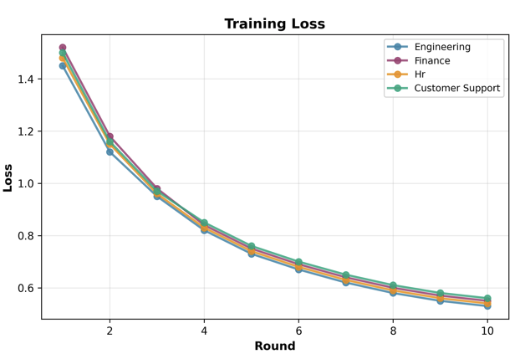
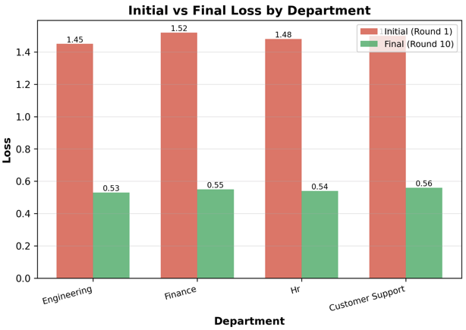
Key Metric: Training Loss
HFL-LoRA significantly reduces training loss, showcasing superior convergence compared to traditional methods.
11

Slide 12
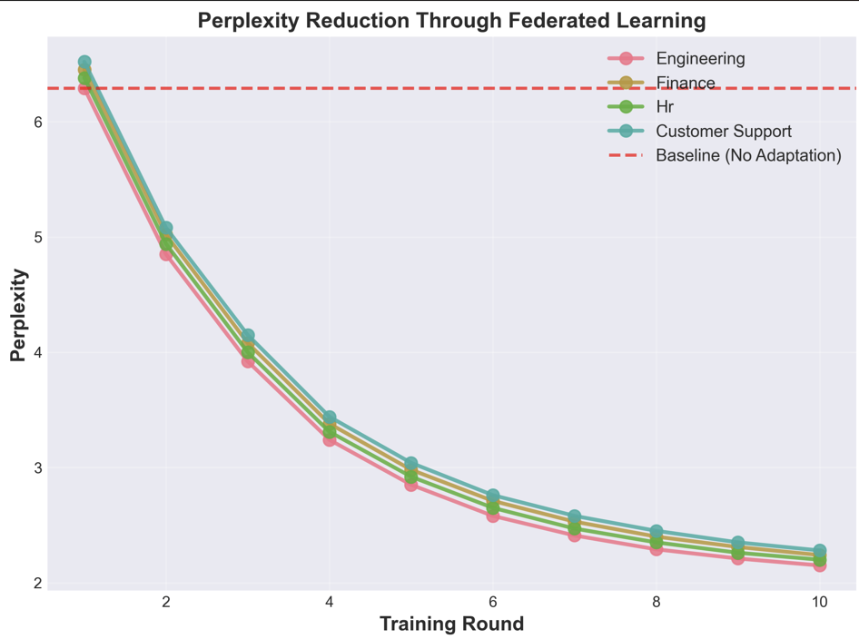
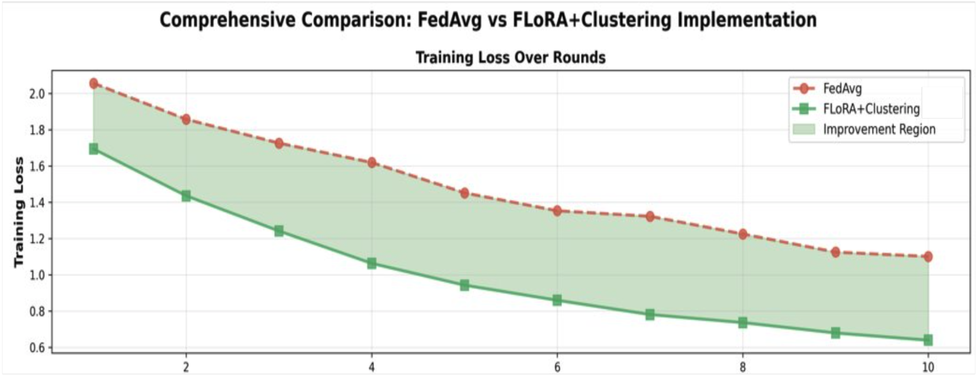

Cumulative Improvement
HFL-LoRA significantly outperforms FedAvg throughout the entire training trajectory, demonstrating consistent and substantial gains.
12

Slide 13
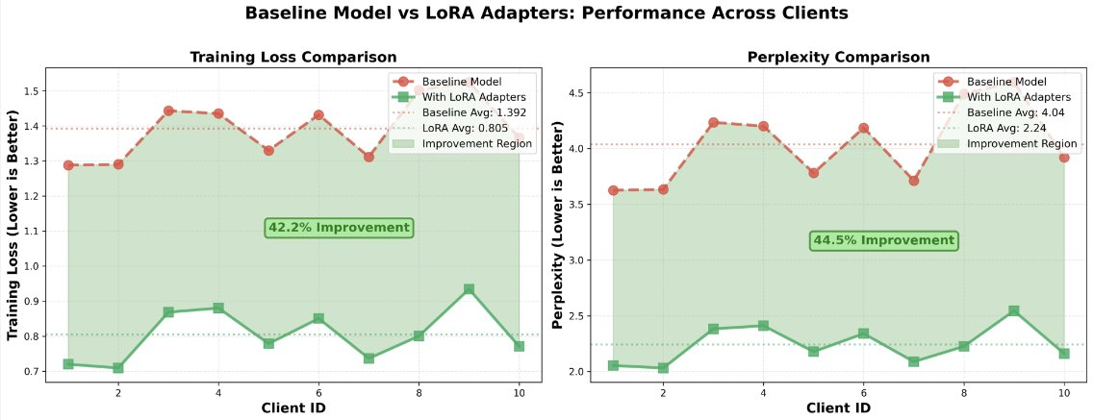

Client Specific Metrics
(Engineering Department)
13

Slide 14

Limitations
While HFL-LoRA offers significant advancements, it's important to acknowledge current limitations that highlight avenues for future research and development.
Limited Testing
Synchronous Update
Use of only small size LLMs
Quantization of model
13

Slide 15

Future Directions
Building on HFL-LoRA's foundation, our future work will focus on enhancing adaptability, privacy, and efficiency for even more robust federated learning solutions.
Asynchronous updates handling
Choosing different rank parameters as per data
Multi model learning
Quick adaption of learning on addition of new clients or departments
15

Slide 16
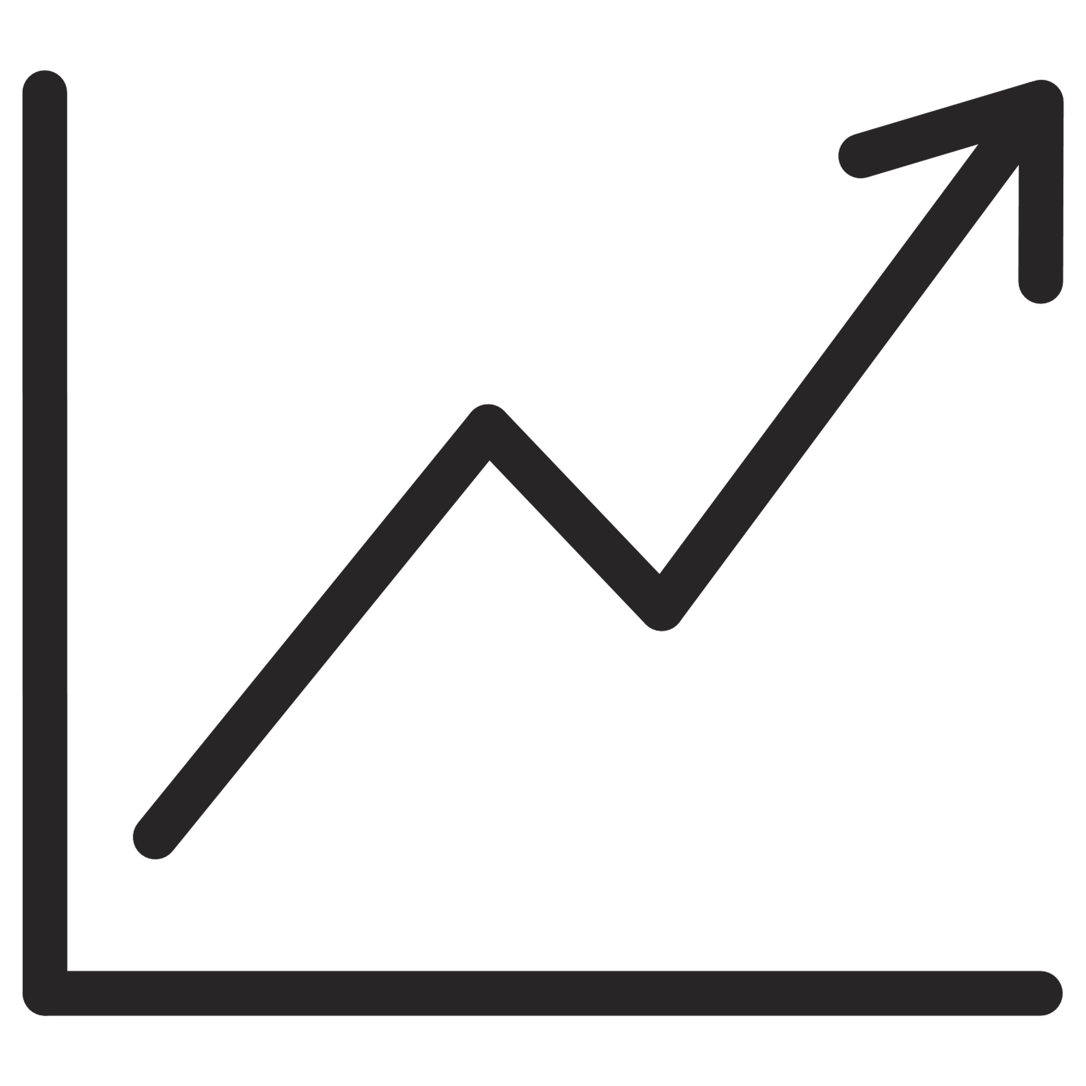



Conclusion
Reduced Training Loss
Stable Convergence
Automatic Domain Clustering
Strong Privacy Guarantees
16

Slide 17
Thank You
17

